Slide 1

LARAVEL
MIGRATION
TINKER
SEEDER
FACTORY
Notes:
le parsing json de la request et de la réponse (du coup ausi j'ai vu, c'est specifique aux POST/PUT)
req.body
accessoirement la gestion des erreur dans le catch

Slide 2

# OBJECTIVES FOR TODAY
MIGRATOIN
TINKER
SEEDER
FACTORY

Slide 3



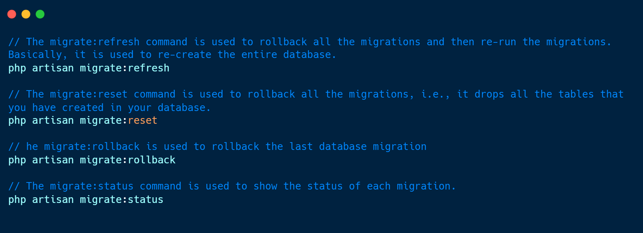
EXPLAIN
# Migration command
05 MNI
Laravel Migration is an essential feature in Laravel that allows you to create a table in your database. It allows you to modify and share the application's database schema. You can modify the table by adding a new column or deleting an existing column.
What is migration?
Why we use it?
Example

Slide 4
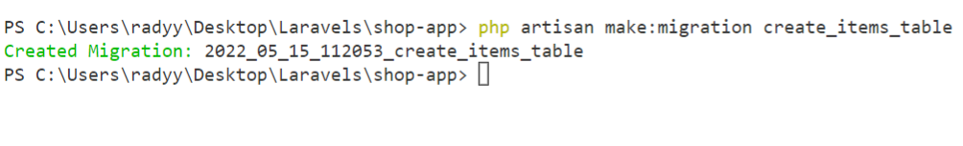
EXPLAIN
# Create migration table
05 MIN
keyword
php artisan make:migration create_table_name_table
keyword
Example

Slide 5
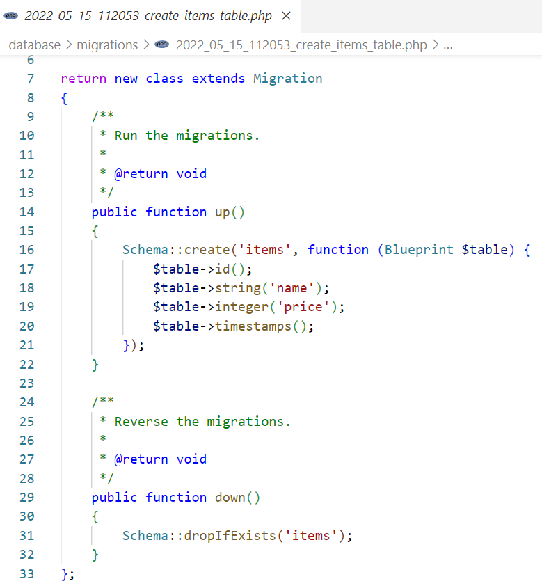
EXPLAIN
# Create migration table
05 MIN
Table name
up function use for create table
https://laravel.com/docs/5.0/schema
down function use for drop table

Slide 6
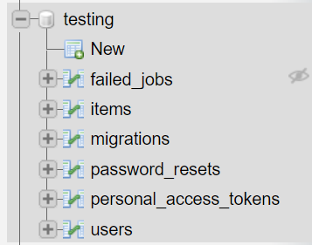
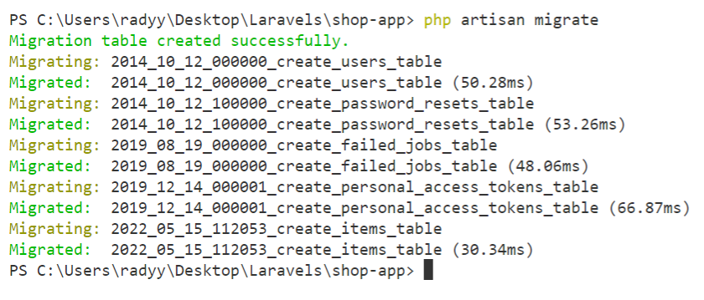
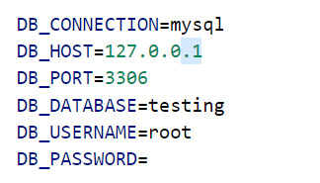
EXPLAIN
# Migrate table
05 MNI
Step1: Create database name: testing
Example
Step2: Configure database in .env file
Step3: php artisan migrate

Slide 7
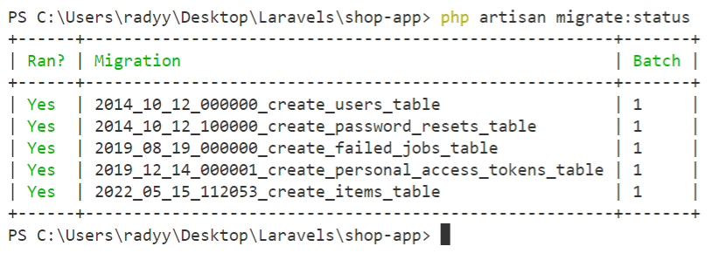
EXPLAIN
# Migrate status
05 MNI
php artisan migrate:status
Example

Slide 8
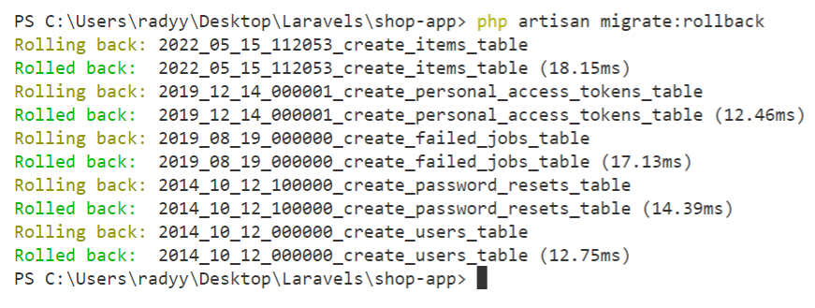
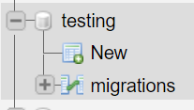
EXPLAIN
# Migrate Rollback
05 MNI
php artisan migrate:rollback
Example

Slide 9
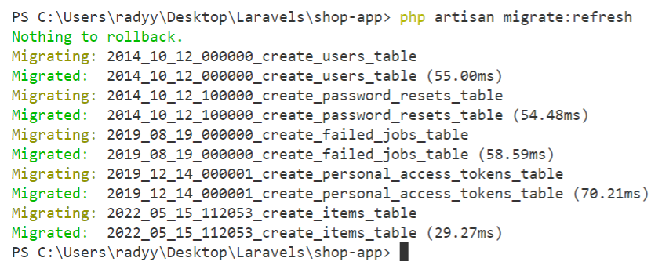
EXPLAIN
# Migrate Refresh
05 MNI
php artisan migrate:refresh
Example

Slide 10


PRACTICE
Activity 1
5 MIN
INDIV
Use artisan command
Create table name: products
Migrate table to database: php artisan migrate
Check migrate status: php artisan migrate:status
Drop all table in your database: php artisan migrate:rollback
Reset table and re-create again: php artisan migrate:refresh

Slide 11
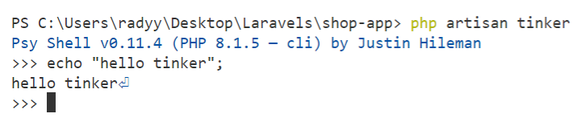
EXPLAIN
# Tinker
05 MNI
Laravel Tinker allows you to interact with a database without creating the routes. Laravel tinker is used with a php artisan to create the objects or modify the data.
Example
php artisan tinker

Slide 12
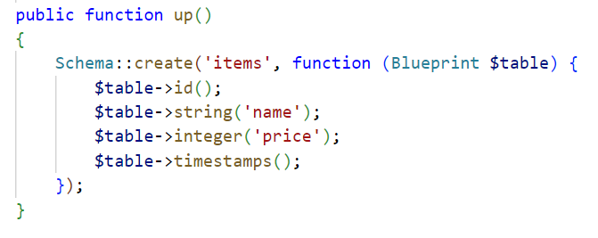
EXPLAIN
# Tinker
05 MNI
Step 1: Create model name: Item
Step 2: Add Columns: name and price to items table
Step 3: php artisan migrate:refresh
Example
Notes:
https://laravel.com/docs/5.0/schema
https://www.codegrepper.com/code-examples/php/laravel+data+types

Slide 13
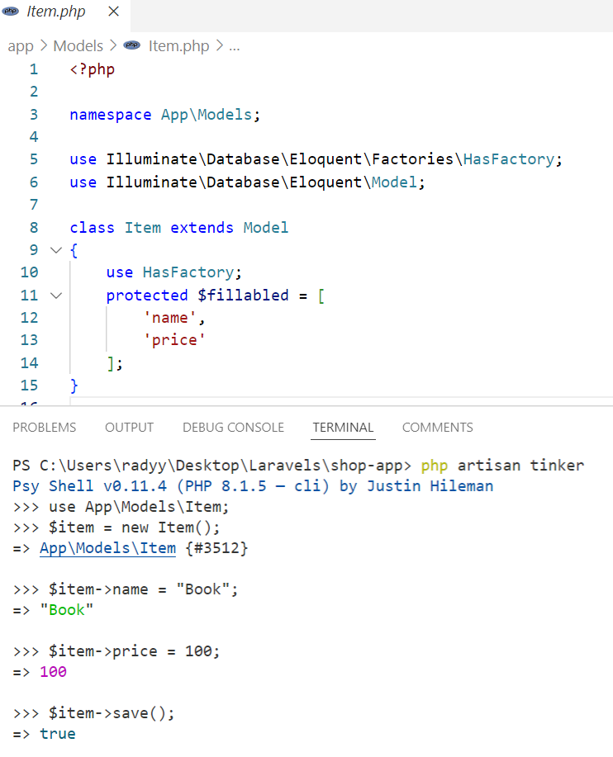
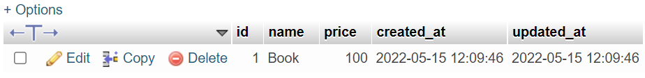
EXPLAIN
# Tinker
05 MNI
Example

Slide 14
PRACTICE
Activity 2
5 MIN
INDIV
Use artisan commands
In products table add 3 columns: name, price and description
Create Product model and fillable all 3 columns.
Use Tinker to insert 3 data
https://laravel.com/docs/5.0/schema

Slide 15
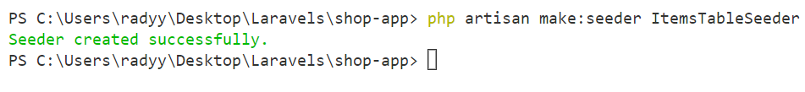
EXPLAIN
# Seeder
05 MIN
php artisan make:seeder YourTableSeeder
Example
Create seeder
Add data to seeder
Use seeder in DatabaseSeeder
1
2
3

Slide 16
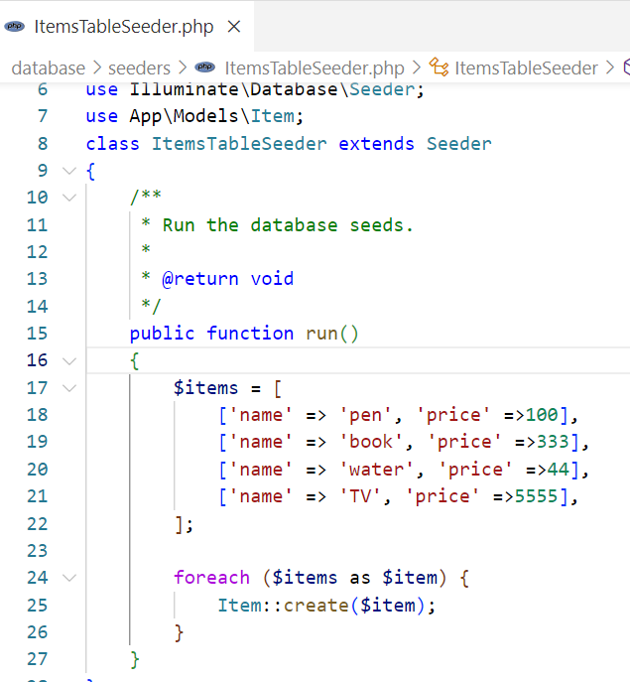
EXPLAIN
# Seeder
05 MIN
Example
Create seeder
Add data to seeder
Use seeder in DatabaseSeeder
1
2
3

Slide 17
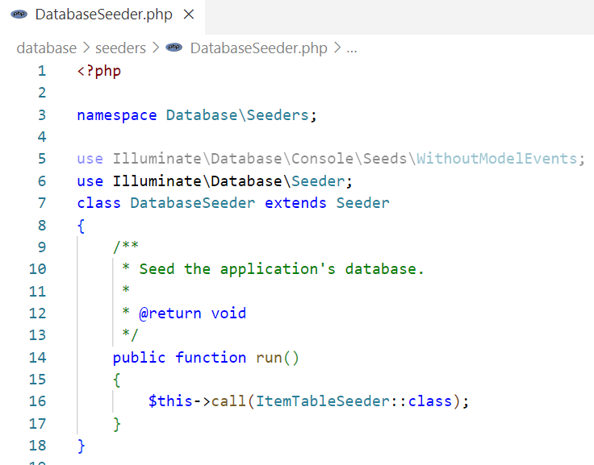
EXPLAIN
# Seeder
05 MIN
Example
Create seeder
Add data to seeder
Use seeder in DatabaseSeeder
1
2
3

Slide 18
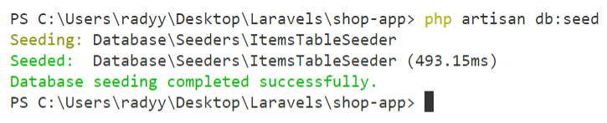
EXPLAIN
# Seeder
05 MIN
There are 2 ways to run seeder
php artisan migrate:reset
1
php artisan migrate --seed
Example
php artisan migrate:refresh
2
php artisan db:seed
Noted: if you are not run migrate:reset or migrate:refresh you will get duplicate data.

Slide 19
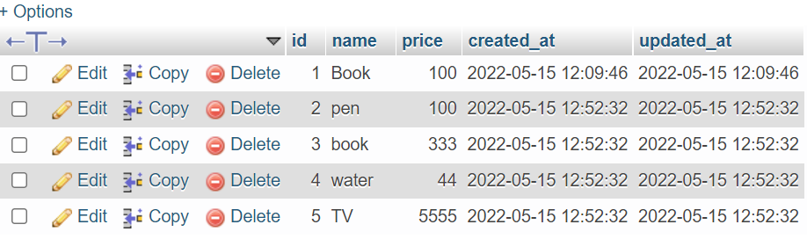
PRACTICE
Activity 3
5 MIN
INDIV
Use artisan command
Create seeder name: ProductsTableSeeder
Add 5 data to your products table using seeder

Slide 20
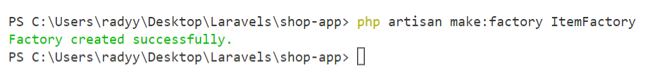
EXPLAIN
# Factory
05 MIN
php artisan make:factory YourFactory
Example
Create factory
Add data to factory
Use factory in DatabaseSeeder
1
2
3

Slide 21
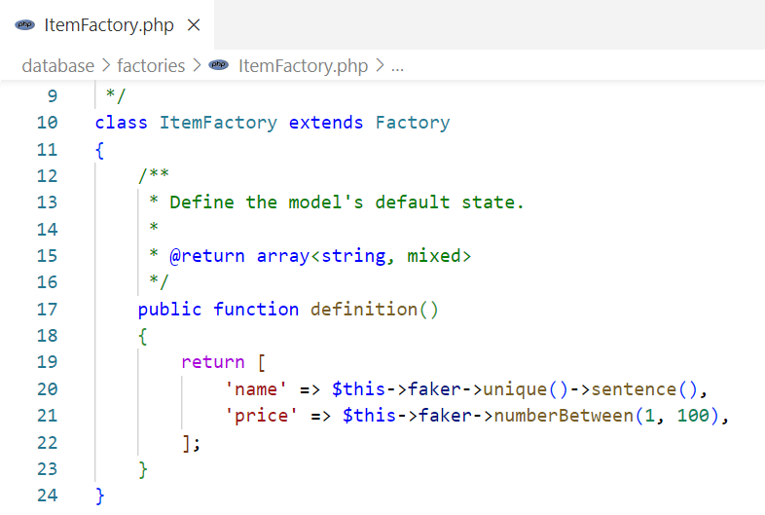
EXPLAIN
# Factory
05 MIN
https://github.com/fzaninotto/Faker
Create factory
Add data to factory
Use factory in DatabaseSeeder
1
2
3
Notes:
https://github.com/fzaninotto/Faker

Slide 22
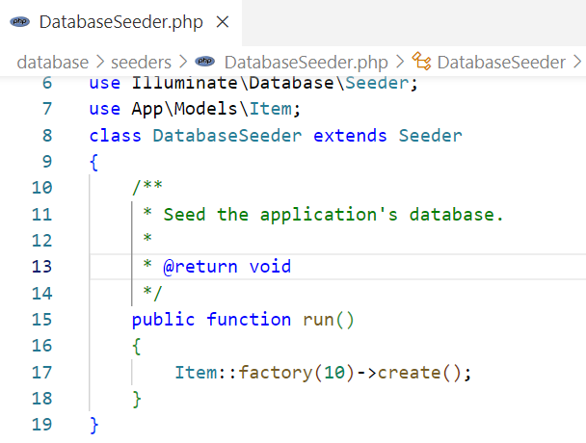
EXPLAIN
# Factory
05 MIN
Import your model
Ex. Create 10 data in items table
Create factory
Add data to factory
Use factory in DatabaseSeeder
1
2
3
Notes:
https://github.com/fzaninotto/Faker

Slide 23
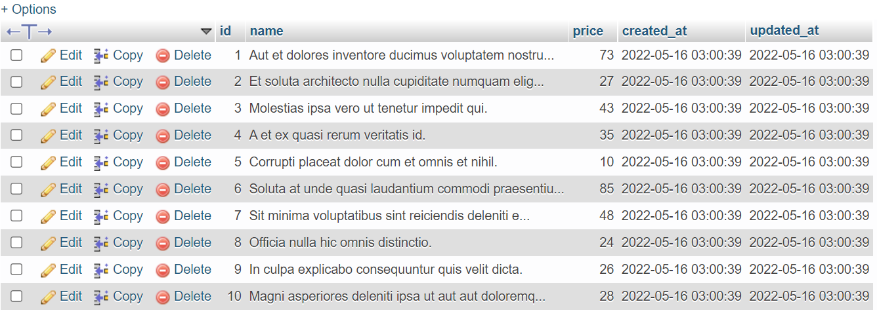

EXPLAIN
# Factory
05 MIN
Run factory
php artisan migrate:refresh
// delete old data (optional)
php artisan db:seed
Create factory
Add data to factory
Use factory in DatabaseSeeder
1
2
3
Notes:
https://github.com/fzaninotto/Faker

Slide 24
PRACTICE
Activity 4
5 MIN
INDIV
Use artisan command
Create ProductFactory
Insert 50 data using faker library with factory

Slide 25
# OBJECTIVES FOR TODAY
MIGRATOIN
TINKER
SEEDER
FACTORY

